Slide 1

Baby Cry Language
Supervised by : DR. Nermeen Elkashaf

Slide 2
Introduction

Slide 3
Problem Statement
Up to 20% of parents report a problem with infant crying and irritability in the first 3 months of life. Crying usually peaks at 6 weeks and abates by 12–16 weeks.
they are most afraid of seeing their baby crying and then not knowing what they should do. This where our app can make some simple judgments for them, so they will be able to know what next step is.

Slide 4
Objective of our Application
Help mothers to communication with her baby easily by detecting the reason of crying
Making it super easy to communicate and ask for help from other mothers

Slide 5
Baby Cry Language
Babies have their own language and, interestingly, it’s the same no matter where your baby was born
This language discover by Priscilla Dunstan, an Australian opera singer
there are five basic sounds your baby makes just before crying

Slide 6

Baby Cry Language
Hungry
Neh
Windy
Heh
Irritated
Eairh
Sleepy
Owh
Burpy
Eh

Slide 7

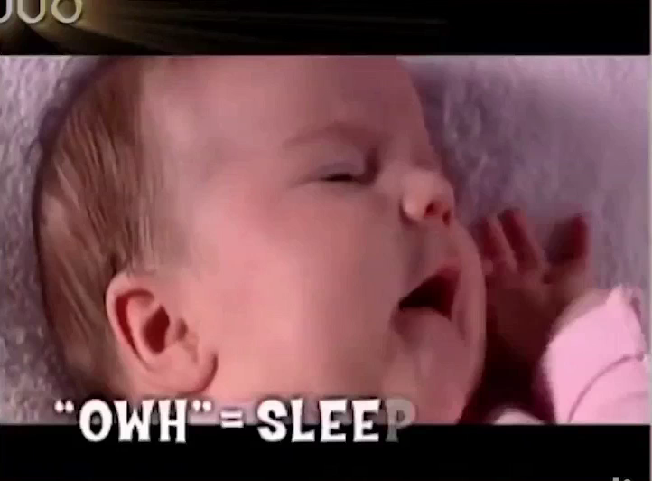
Goal of our Application

Slide 8

Our Competitors

Slide 9
Babba
Cry translator app
Advantage : easy to use and the result of crying baby is accurate
Disadvantage : The result of crying baby takes a long time to load
Baby language
app
Advantage : it provides topics for children’s care and the user interface is good.
Disadvantage : It is not a free application

Slide 10
Why we used Deep Learning?
Because In deep learning, a computer model learns to perform classification tasks directly from images, text, or sound and trained by using large amout of labelled dataset, also neural network architecture learn features directly from the data without the need for manual feature extraction.
Why do we need deep learning in our project?
To automatically extract features from sounds waves and predict new sounds.

Slide 11
Recurrent Neural Network (RNN) is a class of neural networks that allow previous outputs to be used as inputs while having hidden states.
because RNN :
It uses sequential data or time series data.
It can allow data to flow in any direction (feed forward or feedback).
What type of neural network is used? And why?

Slide 12
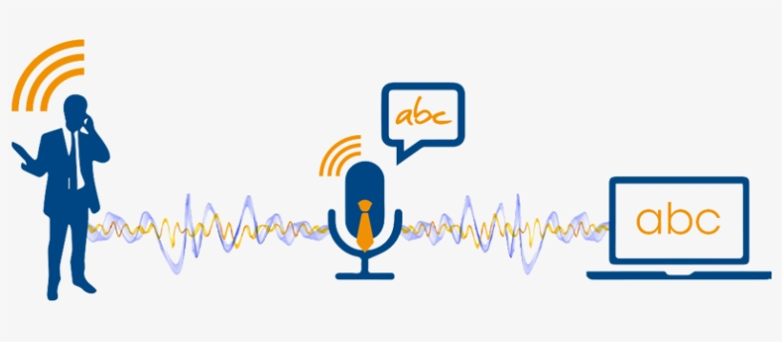
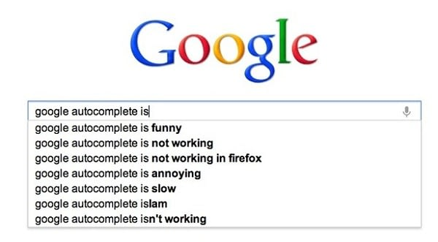
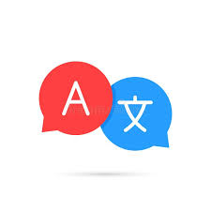
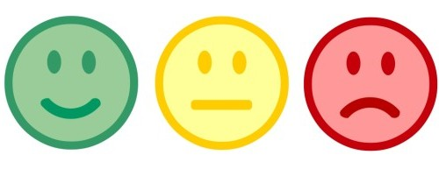
Applications used RNN :
Speech Recognition
Google’s autocompleting
Language Translation
Sentiment Classification

Slide 13
Long Short-Term Memory (LSTM) :
LSTM networks are a type of RNN that uses special units in addition to standard units.
LSTM units include a 'memory cell' that can maintain information in memory for long periods of time.
The LSTM does have the ability to remove or add information to the cell memory carefully regulated by structures called gates.

Slide 14
Diagram of the LSTM network

Slide 15
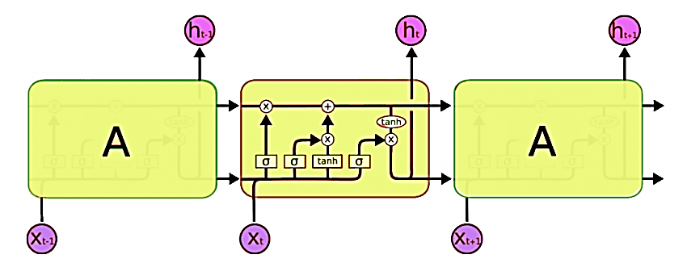

Slide 16
An LSTM has three of these gates :
Forget gate
Input gate
Output gate

Slide 17
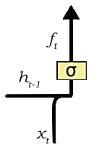
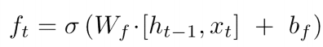
A forget gate :
It is responsible for removing information from the cell state. The information that is no longer required for the LSTM to understand things or the information that is of less importance is removed.

Slide 18
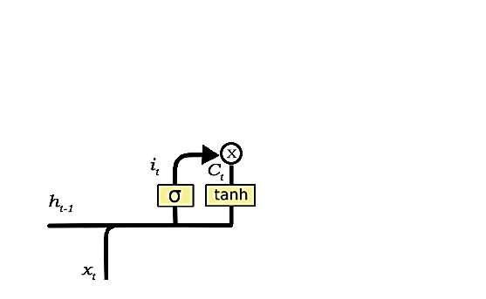
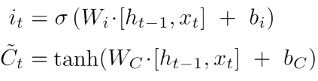
The input gate :
It is responsible for the addition of information to the cell state.

Slide 19
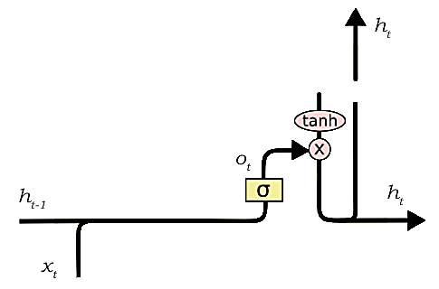
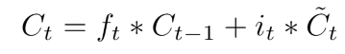
The output gate :
The output gate purpose is to separate the final memory from the hidden state.

Slide 20
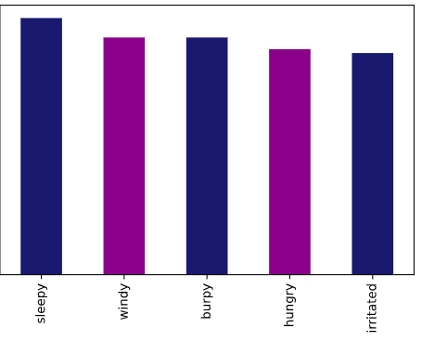
Dataset
Dataset contains 5 classes sleepy, windy, hungry, burpy and irritated.
A balanced dataset is the one that contains equal or almost equal number of samples from all classes.

Slide 21
Cleaning audio files from dataset
We must resample all audio files such that all files in dataset will have the same frequency (data points per second) is 16000 khz.
We must audio cleaning is done by preview the signal envelope at a threshold to remove low magnitude data.
Each audio file in dataset must split into various audio files each one of them is of one second duration.

Slide 22
Why we used Keras?
Keras has support for convolutional and recurrent neural networks. It supports other common utility layers like dropout, batch normalization, and pooling.
User friendly.
Ease of learning and ease of model building.
Keras offers the advantages of broad adoption, support for a wide range of production deployment options, integration with at Least five back-end engines (TensorFlow, CNTK, Theano, MXNet, and PlaidML).
Strong support for multiple GPUs and distributed training.
Keras is backed by Google, Microsoft, Amazon, Apple, Nvidia, Uber, and others.

Slide 23
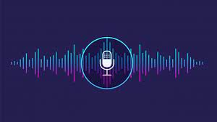



Our case
Irritated %
Burpy %
Windy %
Sleepy %
Hungry %
?
Train Data
LSTM
Trained Model

Slide 24
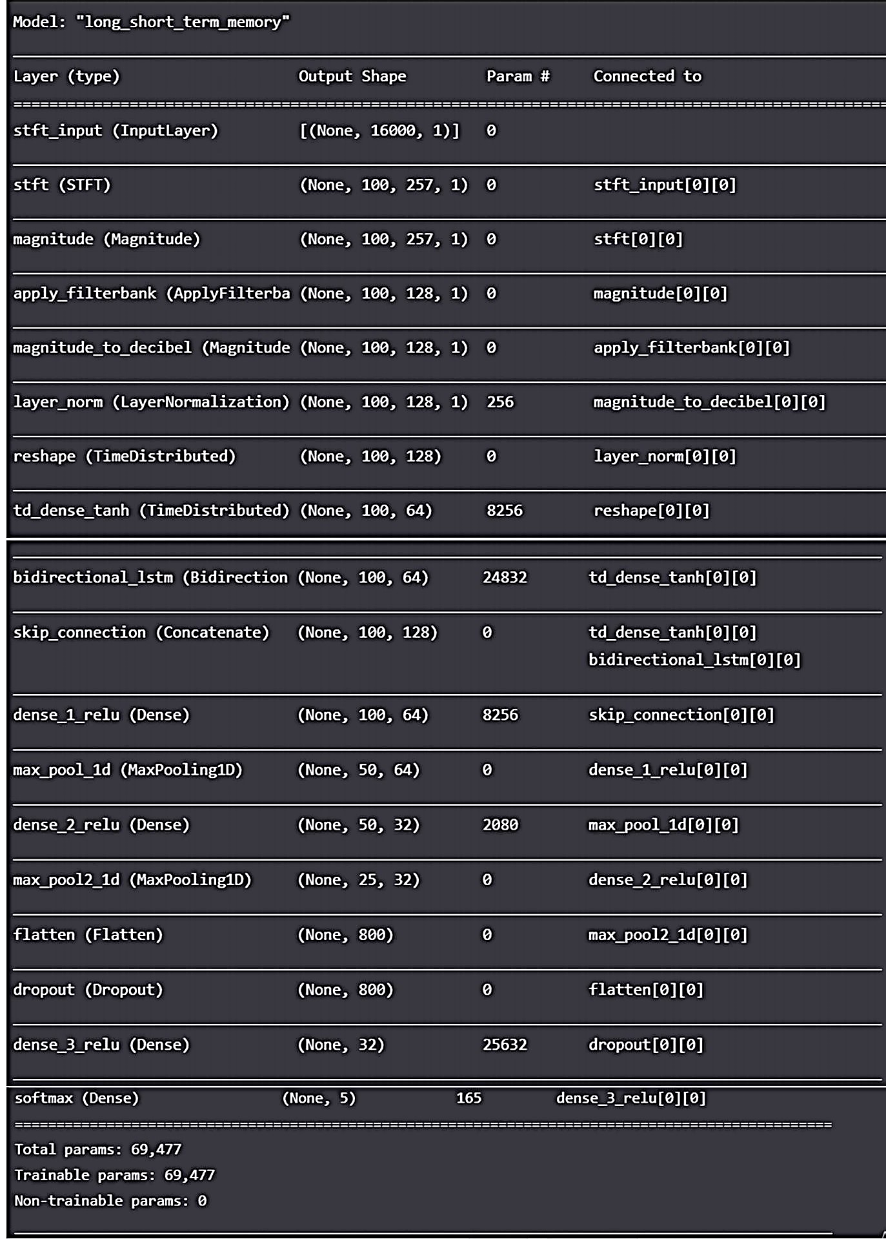
Define Network

Slide 25
It transforms the simple sequence of layers that we defined into a highly efficient series of matrix transforms in a format intended to be executed on our GPU or CPU, depending on how Keras is configured.
It is always required after defining a model. Compilation requires a number of parameters to be specified.
Compile Network
The optimization algorithm.
The loss function.
Metric.

Slide 26
Fit Network
The network is trained using the backpropagation algorithm and optimized according to the optimization algorithm and loss function specified when compiling the model.

Slide 27
Evaluate Network
The model evaluates the loss across all of the test patterns, as well as any other metrics specified when the model was compiled, like classification accuracy.
The accuracy of our model was evaluated to be: 75%.

Slide 28
Make Predictions
When the new audio is given to model to predict output, The output is not in the form of a certain class, instead each class of our five classes is given a percentage, this percentage shows how much likely that the reason for crying is associated with that specific class.

Slide 29
Technologies used

Slide 30

Flutter
Flutter is a free and open-source mobile UI framework created by Google and released in May 2017. In a few words, it allows you to create a native mobile application with only one codebase. This means that you can use one programming language and one codebase to create two different apps (for iOS and Android).

Slide 31
Why we used flutter?
Simple to learn and use
Flutter is way simpler to create mobile applications with it.
The best thing about Flutter is that you can create a real native application without a bunch of code.
Fast Development
Thanks to Flutter, you can change your code and see the results in real time. It is called Hot-Reload. Significant modifications force you to reload the app. But if you do work like design, and change the size of an element, it is in real-time!
Good documentation
You can learn a lot from Flutter's documentation, and everything is very detailed with easy examples. Each time you face a problem with any of the widgets, you will be able to check the documentation and the answer will be there.

Slide 32

Firebase
Firebase is a mobile and web application computing and development platform developed by Google. In 2014, Google acquired the original developers. the tools it gives you cover a large portion of the services that developers would normally have to build themselves, but do not really want to build, because they would rather be focusing on the app experience itself.
This includes things like analytics, authentication, databases, configuration, file storage, push messaging, and the list goes on. The services are hosted in the cloud, and scale with little to no effort on the part of the developer.

Slide 33
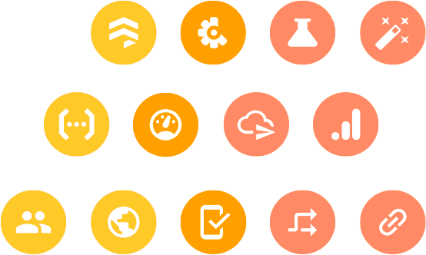
Firebase authentication
Firebase makes authentication easy for end users and developers. Most applications need to know the identity of a user so they can provide a customized experience and keep their data secure.
After a successful sign in, we can access the user's basic profile information, and we can control the user's access to data stored in other Firebase products. We can also use the provided authentication token to verify the identity of users in backend services.

Slide 34
Firebase authentication
The user information contains a unique ID which is guaranteed to be distinct across all providers, never changing for a specific authenticated user. This unique ID is used to identify our user and what parts of our back-end system they are authorized to access.

Slide 35
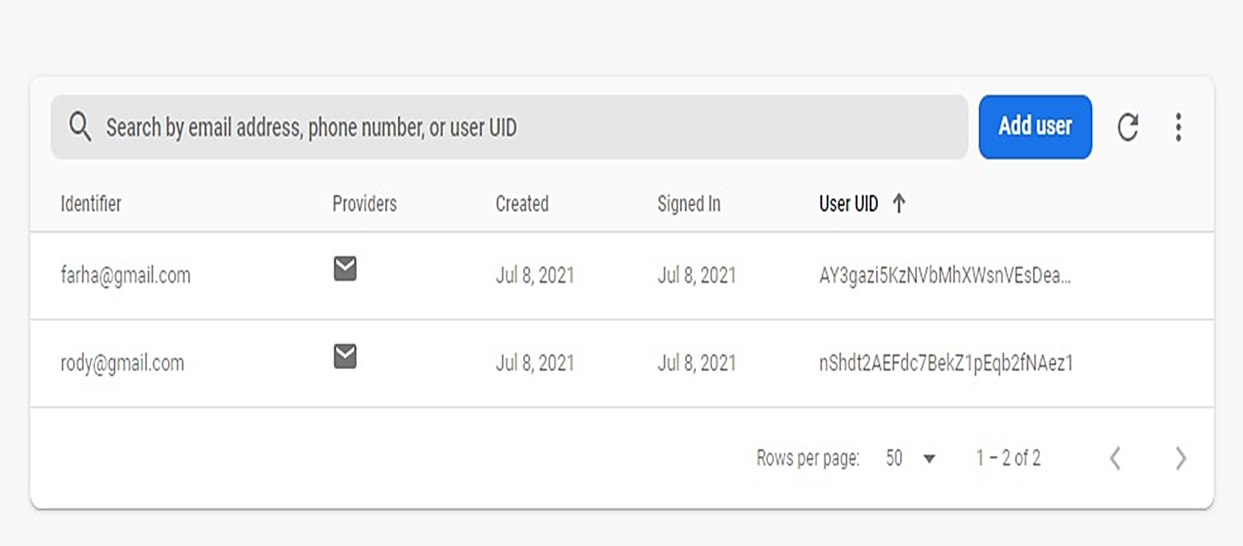
Registered users

Slide 36
Cloud Firestore
No matter what kind of app you are developing these days, there is a good chance you will want to store your data in the cloud. But storing data in the cloud is not quite as easy as it first looks. You have to set up your own servers to host the data and keep them up and running day and night. You have got to spend a lot of time on the client dealing with networking issues, making sure everything still works when your user goes offline.

Slide 37
Cloud Firestore
You need to stay up all night wondering if you have gotten your security exactly right. And then you need to make sure your service can scale no matter how many millions of users you might have, all of which is time you do not get to spend on building your app. This is where Cloud Firestore comes in. Cloud Firestore lets you store your data in the cloud, so you can sync it across all your devices or share them among multiple users.

Slide 38
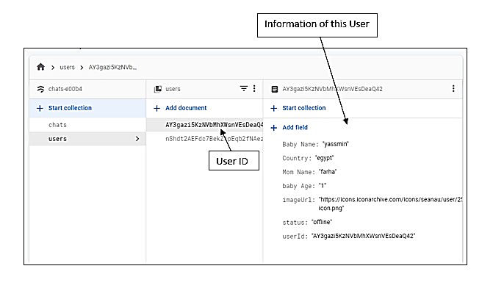
Users’ info

Slide 39
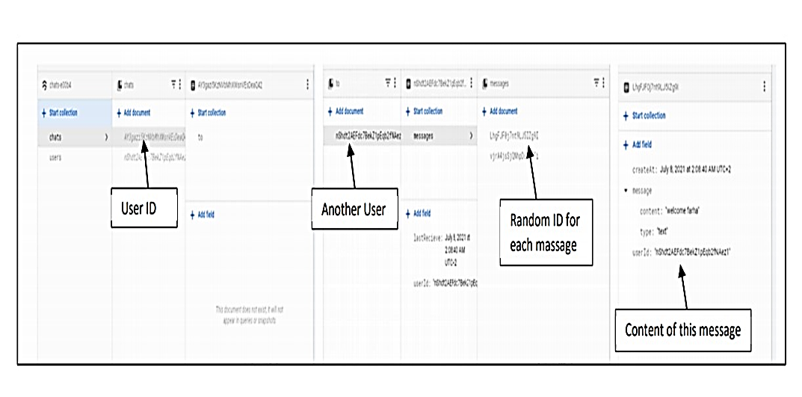
Chats

Slide 40
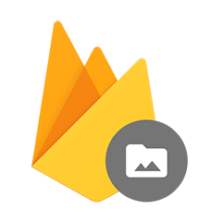
Cloud storage
We all know from experience that people love to share things about themselves, such as photos, videos, and GIFs that express their feelings. That is where Firebase Storage can help. Storage API lets users' upload files to cloud so they can be shared with anyone else. And if ther is specific rules for sharing files with certain users, we can protect this content for users logged in with Firebase authentication. Security, of course, is our first concern. All transfers are performed over a secure connection.

Slide 41
Cloud storage
Also, all transfers with API are robust and will automatically resume in case the connection is broken. This is essential for transferring large files over slow or unreliable mobile connections. And, finally, our storage, backed by Google cloud storage, scales to petabytes--that's billions of photos--to meet our app's needs. So, we will never be out of space when we need it

Slide 42
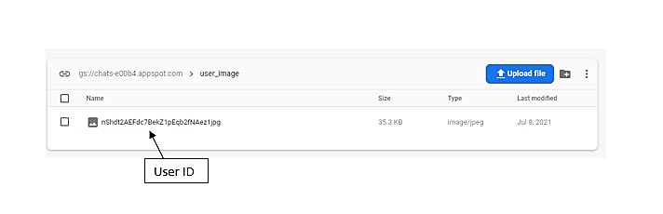
Image Upload

Slide 43
App design

Slide 44


Splash screen
App logo

Slide 45
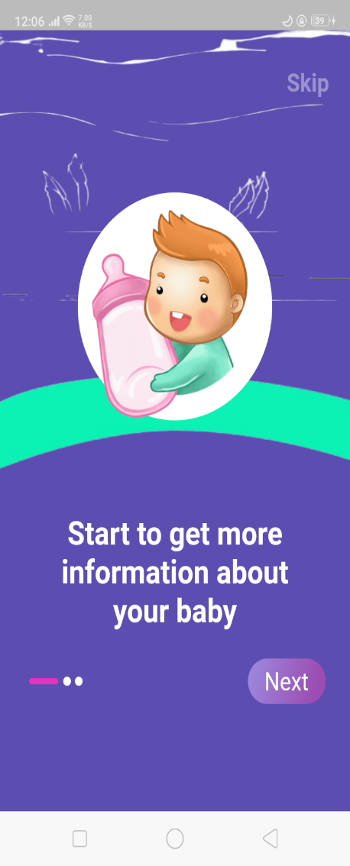
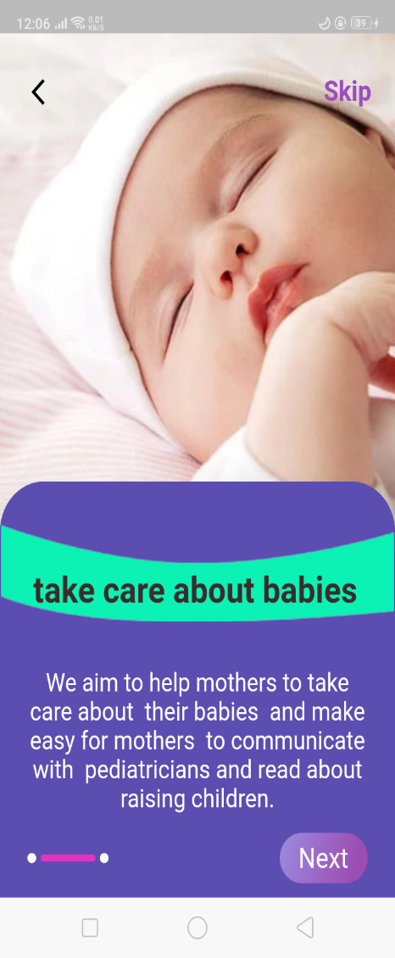
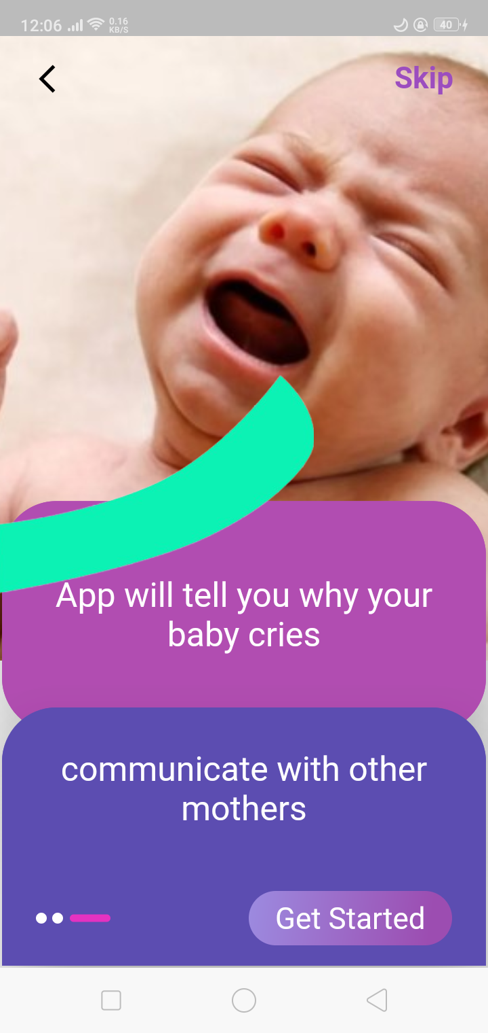
Onboarding screens

Slide 46
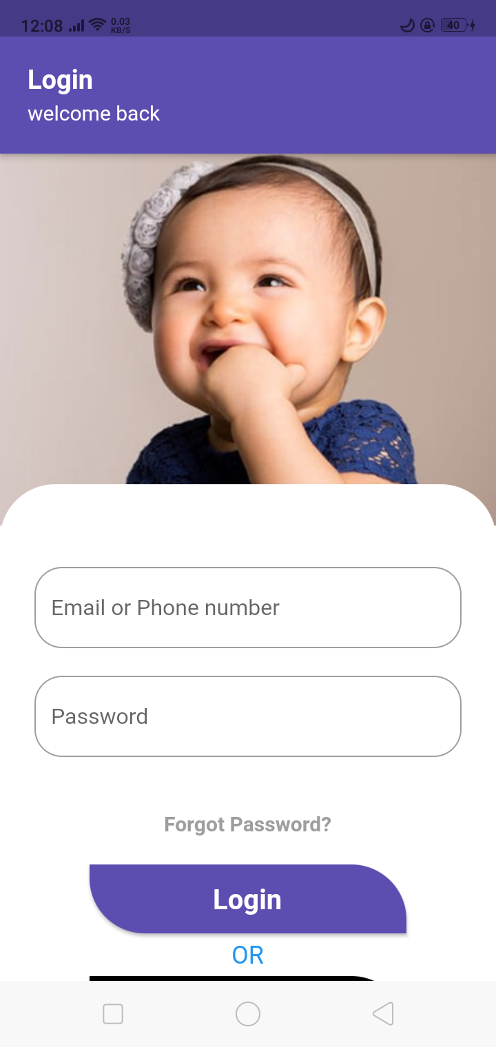
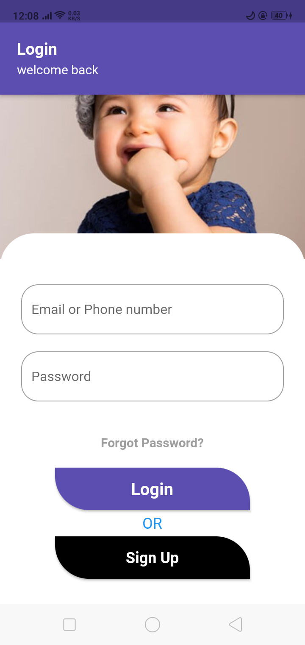
Log in

Slide 47
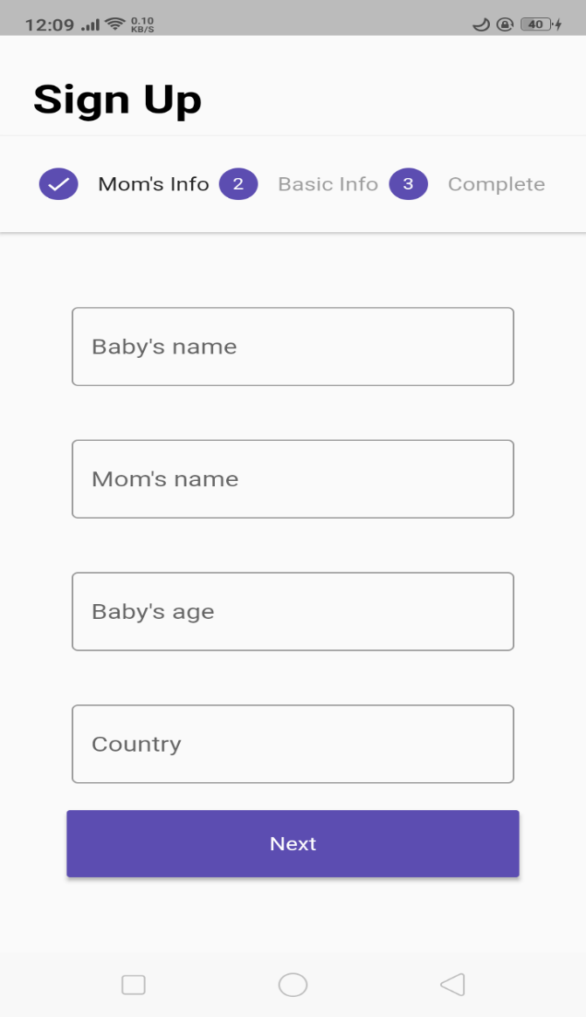
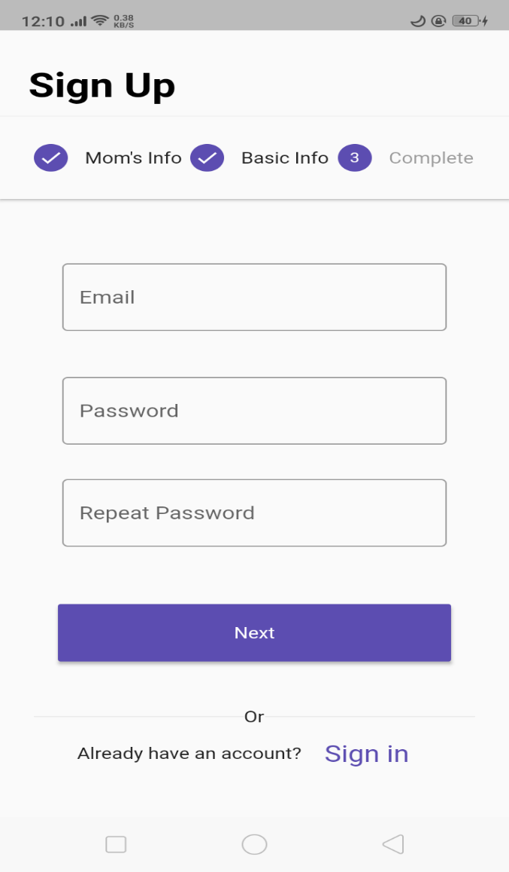
Sign up

Slide 48
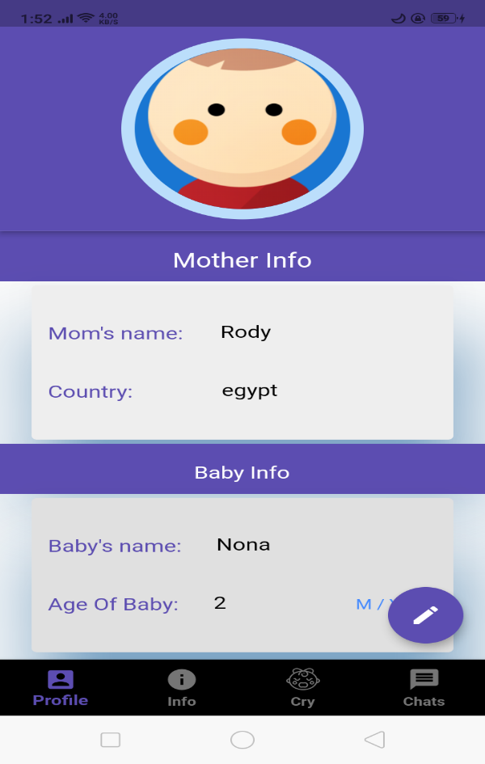
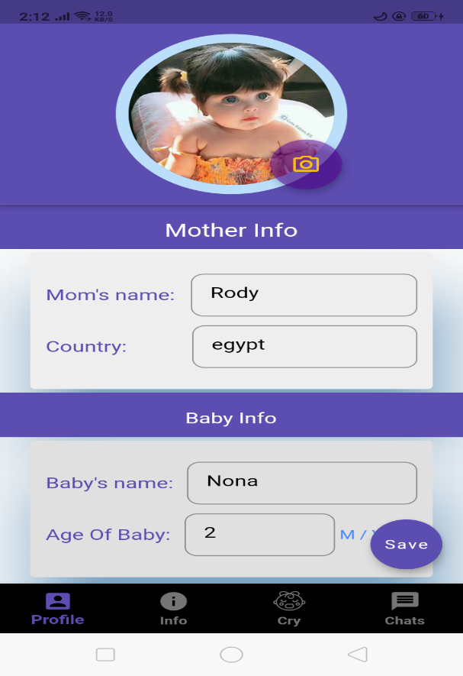
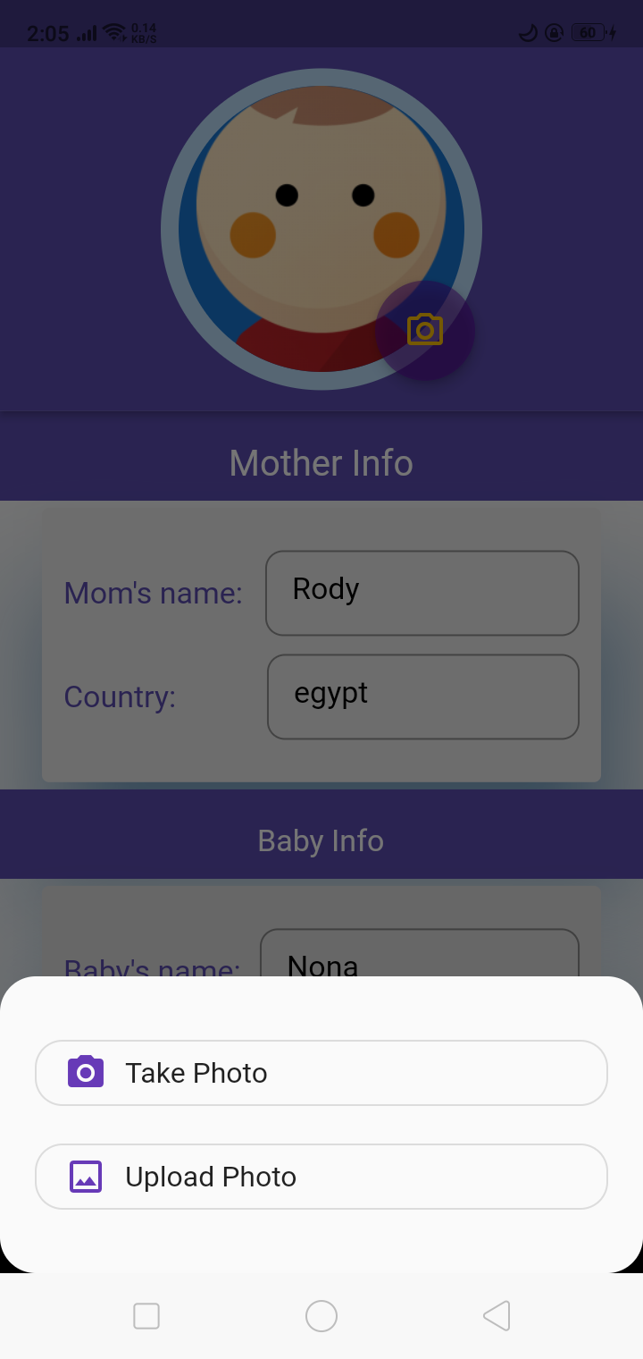
Profile page

Slide 49
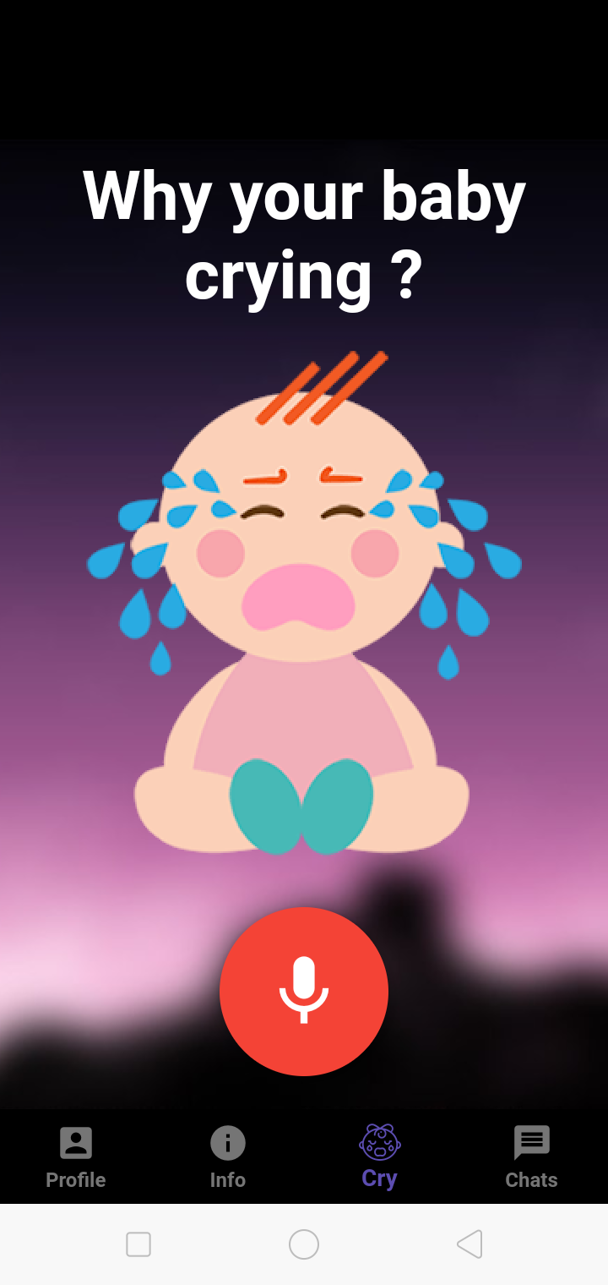
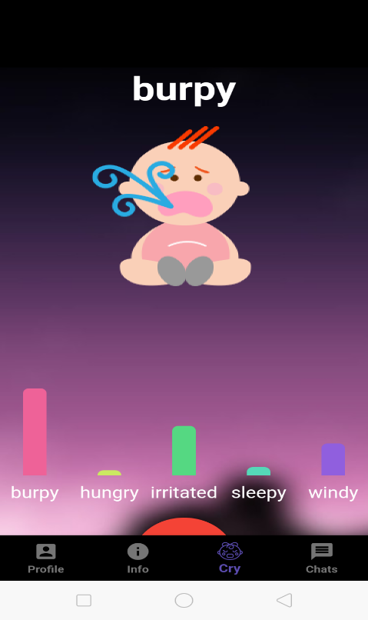
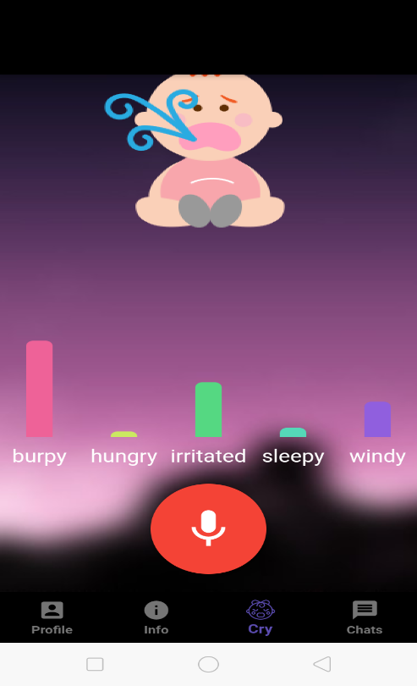
Why your baby crying?

Slide 50
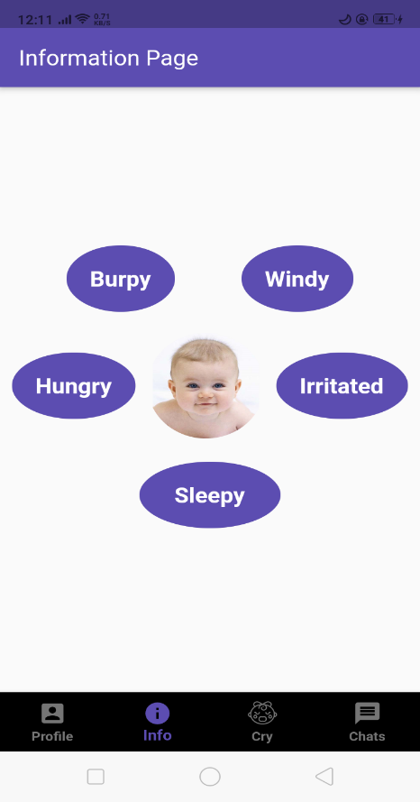
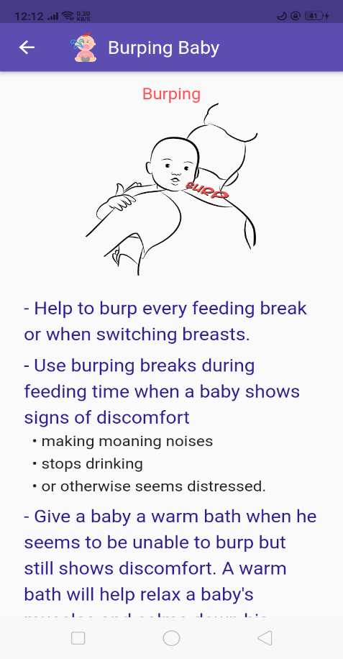
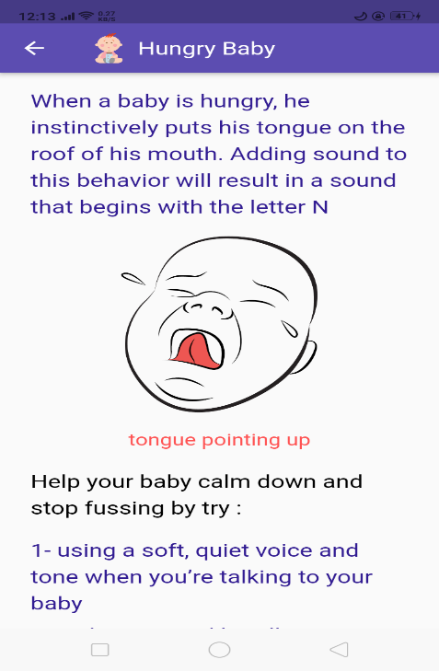
Info screens

Slide 51
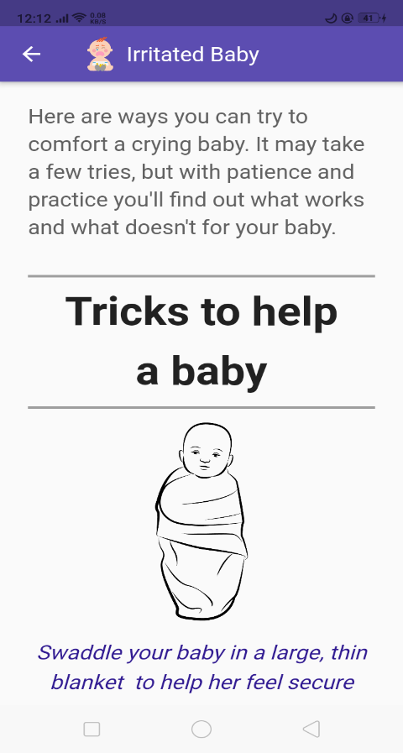
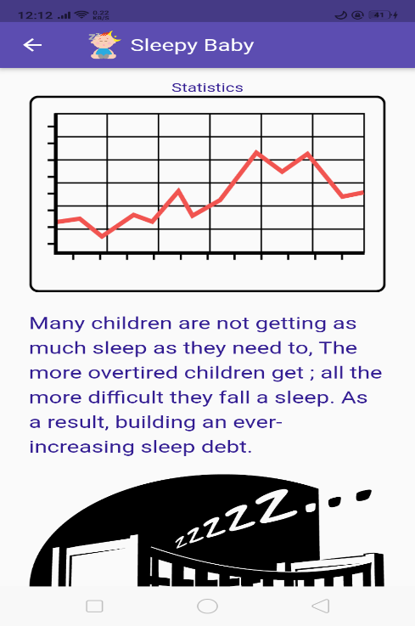
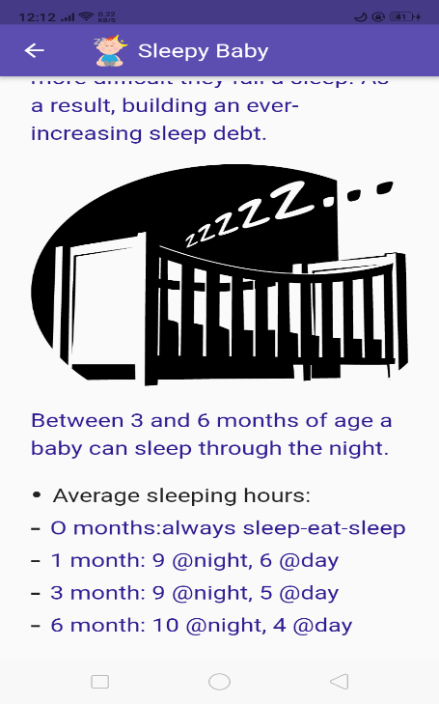
Info screens

Slide 52
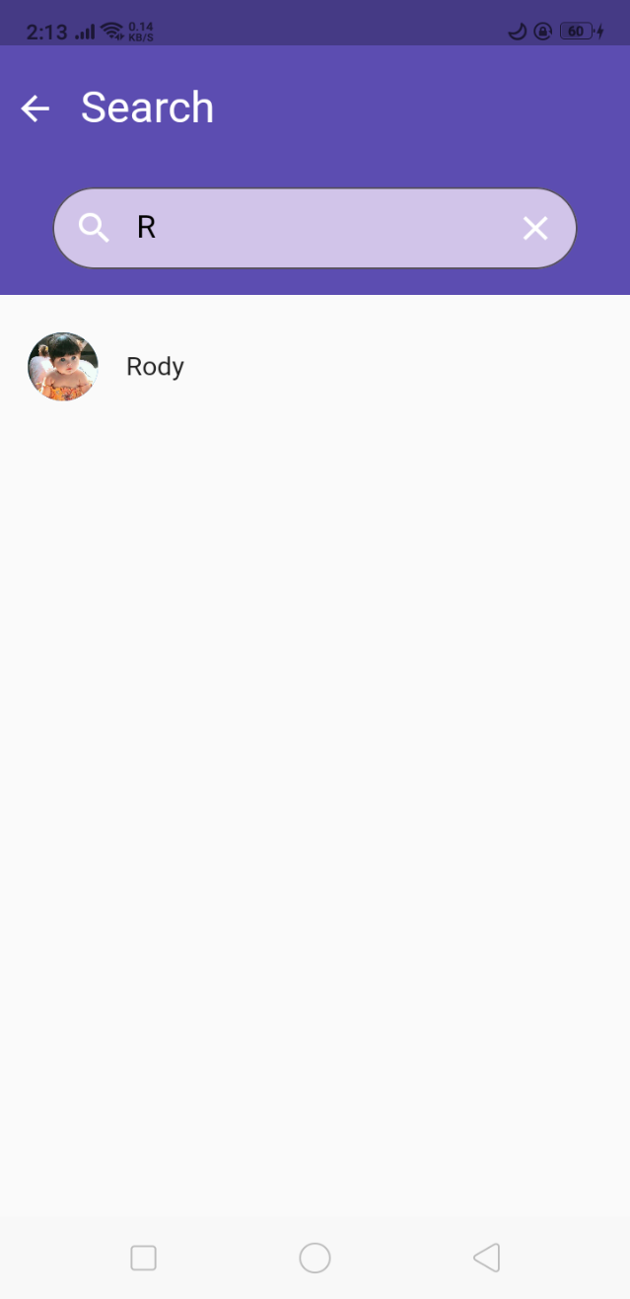
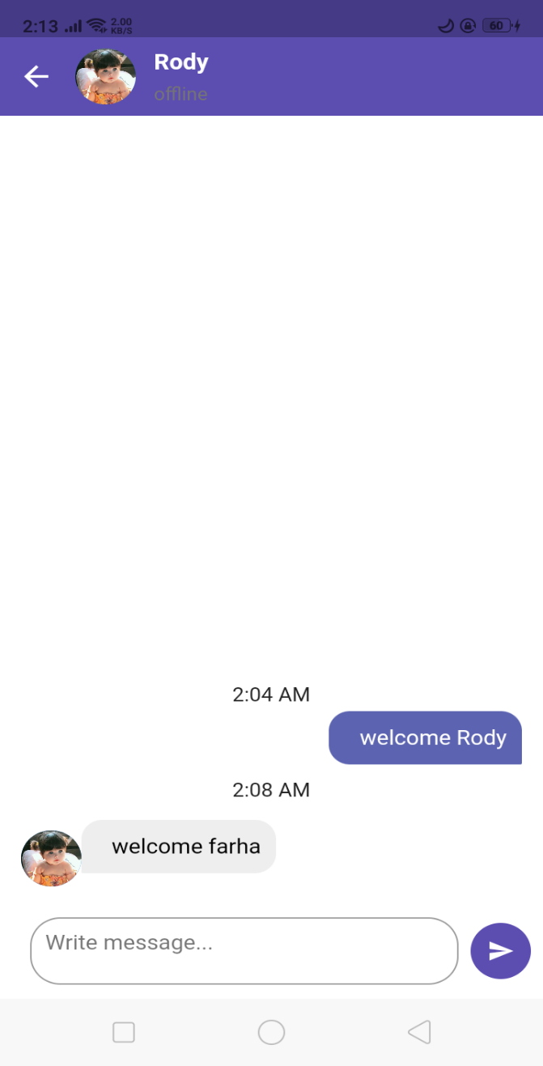
Chats

Slide 53
Thank you

